Slide 1


Presented by:
Neha
22322810
CROPSMART

Slide 2
Objective:
The objective of the Crop Recommendation System is to analyze environmental factors such as soil properties, weather conditions, and nutrient levels to recommend the most suitable crop for a specific region or field.This helps farmers make informed decisions, optimize crop yields, improve productivity, and reduce the risk of crop failure, ultimately leading to better economic outcomes for the farming community.

Slide 3
Stage 1
Importing the Libraries
Stage 2
Data Loading
Stage 3
Data Inspection & Preparation
Stage 4
Exploratory Data Analysis Process
Stage 5
Prediction
Stage 6
Training & Evaluation

Slide 4
Stage 1
Importing The Libraries
Numpy
NumPy (Numerical Python) is a Python library that excels in array operations. It is widely used in mathematical computations, machine learning, and data science.
eg; import numpy as np
Pandas
pandas is a fast, powerful, flexible and easy to use open source data analysis and manipulation tool, built on top of the Python programming language.
eg; import pandas as pd

Slide 5
Matplotlib
The most popular Python library for data visualization and exploration, with examples of bar graphs, pie charts, box plots, histograms, line charts and scatter plots.
eg; import matplotlib
Scikit-Learn
Scikit-learn is an open source library for predictive data analysis, built on NumPy, SciPy, and matplotlib. It offers simple and efficient tools for classification, regression, clustering and preprocessing.
Seaborn
Seaborn, a visualization library for statistical graphics plotting in Python, built on top of Matplotlib and Pandas.

Slide 6

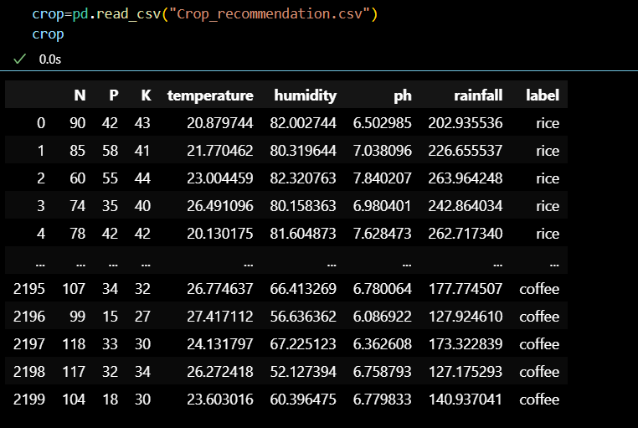
Stage 2
Data Loading
Source of Dataset:
Dataset Source: Kaggle
Dataset Name: Crop_recommendation.csv
Usage: Analyzing such data can provide insights into spending behavior, recommendation the crops, and helps the farmer crop planning.

Slide 7
Stage 3
Data Inspection & Preparation
Data Inspection
Shape: Dataset shape identified using `crop.shape` (rows, columns).
First Five Rows: Previewed the dataset with ‘crop.head()`.
Data Types: Checked data types of all columns with `crop.dtypes`.
Summary: Dataset overview via crop.info()` and statistical summary with ‘crop.describe()`.

Slide 8
Stage 4
Exploratory Data Analysis(EDA) Process:
Exploratory Data Analysis (EDA) is a technique for understanding datasets by summarizing their characteristics, detecting patterns, and uncovering relationships. With the help of EDA process we can create a bar graph, scatter, histogram etc.
Use the libraries
Pandas: For data manipulation and analysis
Numpy: For numerical computing
Matplotlib: For plotting dataset
Seaborn: For plotting dataset

Slide 9
Stage 5
Prediction Modeling
The models used in this project include a combination of supervised learning algorithms to handle both regression and classification tasks, depending on the prediction goals.
Model Used:Multiclass classification problem.
Process:
▪ Data Split: Split into training and testing sets.
▪ Model Training: Trained logistic regression on the selected features
▪ Evaluation: Assessed model using accuracy.
Libraries Used: Scikit-learn for modeling and evaluation.

Slide 10
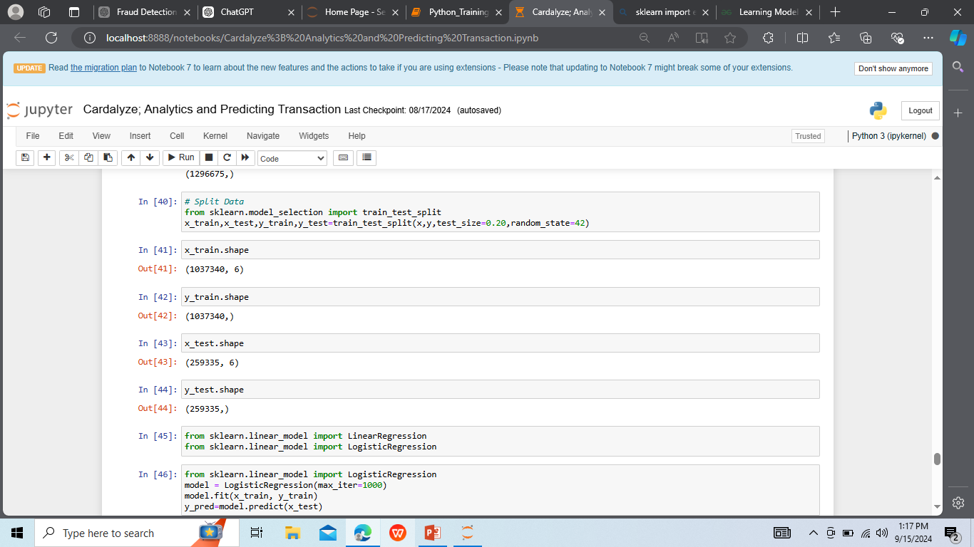
Stage 6
Training & Evaluation
Training Process: The model is fed the training
data, where it learns the relationships between the
input features and the target variable .
After training, the model is tested on the testing dataset to evaluate its performance. Various evaluation metrics are used depending on whether it is a classification or regression task

Slide 11
Future Scope
Improve accuracy
ML can be used to train models that can accurately predict the best crops to grow in a given location.
Increase sustainability
ML can help farmers conserve resources and minimize environmental impact.
Detect pests and diseases
ML can help farmers identify pests and diseases that could damage their crops.
Automate recommendations
ML can automate the process of making crop recommendations, freeing up farmers' time.

Slide 12
THANK YOU

